Slide 1
Operators
An operator is a symbol that performs an operation.
Arithmetic Operators
Relational Operators / Comparison Operators
Logical Operators
Assignment Operators
Bitwise Operators
Membership Operators
Identity Operators
Ternary Operator

Slide 2
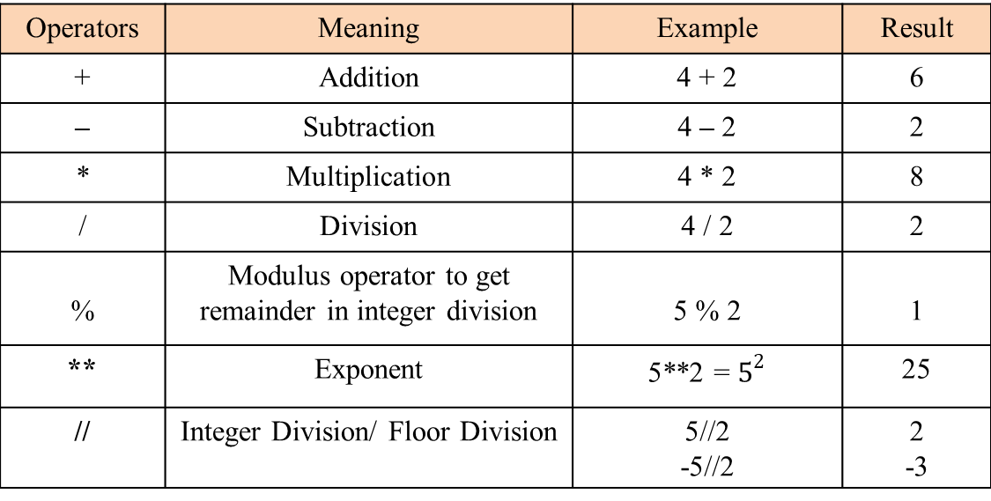
Arithmetic Operators
Arithmetic Operators are used to perform basic arithmetic operations like addition, subtraction, division etc.
Operators | Meaning | Example | Result
+ | Addition | 4 + 2 | 6
– | Subtraction | 4 – 2 | 2
* | Multiplication | 4 * 2 | 8
/ | Division | 4 / 2 | 2.0
% | Modulus operator to get remainder in integer division | 5 % 2 | 1
** | Exponent |  | 25
// | Integer Division/ Floor Division | 4//2.0 -5//2 | 2.0 -3

Slide 3
Relational/ Comparison Operators
Relational operators are used to compare the value of operands (expressions), operands can be any type to produce a logical value. A logical value is either True or False.
Operators | Meaning | Example | Result
< | Less than | 5<2 | False
> | Greater than | 5>2 | True
<= | Less than or equal to | 5<=2 | False
>= | Greater than or equal to | 5>=2 | True
== | Equal to | 5==2 | False
!= | Not equal to | 5!=2 | True

Slide 4
Logical Operators
Logical operators are used to connect more relational operations to form a complex expression called logical expression. A value obtained by evaluating a logical expression is always logical, i.e. either True or False.
Operator | Meaning | Example | Result
and | Logical and | (5<2) and (5>3) | False
or | Logical or | (5<2) or (5>3) | True
not | Logical not | not (5<2) | True

Slide 5
and
Operand 1 | Operand 2 | Result
True | True | True
True | False | False
False | True | False
False | False | False
True | Expression | Expression
False | Expression | False
True and Expression1 and Expression2 = Expression2
False and Expression1 and Expression2 = False

Slide 6
or
Operand 1 | Operand 2 | Result
True | True | True
True | False | True
False | True | True
False | False | False
True | Expression | True
False | Expression | Expression
True or Expression1 or Expression2 = True
False or Expression1 or Expression2 = Expression1

Slide 7
not
Operand | Result
False | True
True | False

Slide 8
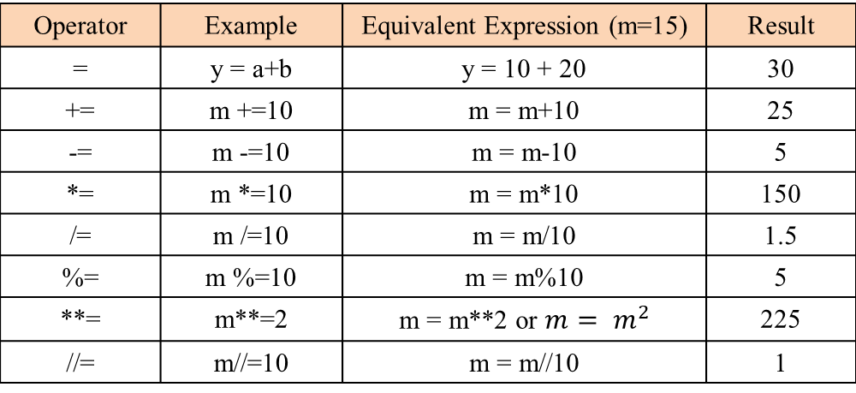
Assignment Operators
Assignment operators are used to perform arithmetic operations while assigning a value to a variable.
Operator | Example | Equivalent Expression (m=15) | Result
= | y = a+b | y = 10 + 20 | 30
+= | m +=10 | m = m+10 | 25
-= | m -=10 | m = m-10 | 5
*= | m *=10 | m = m*10 | 150
/= | m /=10 | m = m/10 | 1.5
%= | m %=10 | m = m%10 | 5
**= | m**=2 | m = m**2 or $m= m^{2}$ | 225
//= | m//=10 | m = m//10 | 1

Slide 9
Bitwise Operators
Bitwise operators are used to perform operations at binary digit level. These operators are not commonly used and are used only in special applications where optimized use of storage is required. Bitwise operators can be performed only on integer and boolean types
Operator | Meaning
& | Bitwise AND
| | Bitwise OR
^ | Bitwise exclusive OR / Bitwise XOR
~ | Bitwise inversion (one’s complement)
<< | Shifts the bits to left / Bitwise Left Shift
>> | Shifts the bits to right / Bitwise Right Shift

Slide 10
Bitwise Operator Description
& If both bits are 1 then only result is 1 otherwise result is 0
| If atleast one bit is 1 then result is 1 otherwise result is 0
^ If bits are different then only result is 1 otherwise result is 0
~ bitwise complement operator i.e 1 means 0 and 0 means 1
>> Bitwise Left shift Operator
<< Bitwise Right shift Operator

Slide 11
Bitwise AND &
Operand 1 | Operand 2 | Result (operand1 & operand2)
True 1 | True 1 | True 1
True 1 | False 0 | False 0
False 0 | True 1 | False 0
False 0 | False 0 | False 0
a = 10
b = 15
0 0 0 0 1 0 1 0
0 0 0 0 1 1 1 1

Slide 12
Bitwise OR |
Operand 1 | Operand 2 | Result (operand1 | operand2)
True 1 | True 1 | True 1
True 1 | False 0 | True 1
False 0 | True 1 | True 1
False 0 | False 0 | False 0
a = 10
b = 15
0 0 0 0 1 0 1 0
0 0 0 0 1 1 1 1

Slide 13
Bitwise XOR ^
Operand 1 | Operand 2 | Result (operand1 ^ operand2)
True 1 | True 1 | False 0
True 1 | False 0 | True 1
False 0 | True 1 | True 1
False 0 | False 0 | False 0
a = 10
b = 15
0 0 0 0 1 0 1 0
0 0 0 0 1 1 1 1

Slide 14
Bitwise NOT ~
Operand | Result (~ operand)
True 1 | False 0
False 0 | True 1
a = 10
0 0 0 0 1 0 1 0

Slide 15
Bitwise Left Shift <<
a = 10
0 | 0 | 0 | 0 | 1 | 0 | 1 | 0
0 | 0 | 1 | 0 | 1 | 0 | 0 | 0
a << 2

Slide 16
Bitwise Right Shift >>
a = 10
0 | 0 | 0 | 0 | 1 | 0 | 1 | 0
0 | 0 | 0 | 0 | 0 | 0 | 1 | 0
a >> 2

Slide 17
Membership Operators
The membership operators are useful to test for membership in a sequence such as string, lists, tuples and dictionaries.
There are two type of Membership operator:-
in
not in

Slide 18
in
This operators is used to find an element in the specified sequence.
It returns True if element is found in the specified sequence else it returns False.
Ex:-
st1 = “Welcome to geekyshows”
“to” in st1
st2 = “Welcome top geekyshows”
“to” in st2
st3 = “Welcome to geekyshows”
“subs” in st3
True
True
False

Slide 19
not in
This operators works in reverse manner for in operator.
It returns True if element is not found in the specified sequence and if element is found, then it returns False.
Ex:-
st1 = “Welcome to geekyshows”
“subs” not in st1
st2 = “Welcome to geekyshows”
“to” not in st2
st3 = “Welcome top geekyshows”
“to” not in st3
True
False
False

Slide 20
Identity Operators
The identity operators compare the memory locations of two objects. Hence, it is possible to know whether two objects are same or not.
r1 is r2 returns True if both r1 and r2 are pointing to the same object
r1 is not r2 returns False if both r1 and r2 are not pointing to the same object
There are two types of Identity operator:-
is
is not

Slide 21
is
This operator is used to compare whether two objects are same or not.
It returns True if memory location of two objects are same else it returns False.
Ex:-
a = 10
b = 10
a
b
10
10
12411
12411
a is b
True
a
b
a = 10
b = ‘10’
10
‘10’
18511
16211
a is b
False

Slide 22
is not
This operator works in reverse manner for is operator.
It returns True if memory location of two objects are not same and if they are same it returns False.
Ex:-
a = 10
b = 10
a
b
10
10
12411
13611
a is not b
False
a
b
a = 10
b = ‘10’
10
‘10’
18511
16211
a is not b
True

Slide 23
Ternary Operator
Syntax:
x = firstValue if condition else secondValue
If condition is True then firstValue will be considered else secondValue will be considered.
min= a if a<b else b max= a if a>b else b
Eg: Program to print biggest of three numbers
a=int(input("Enter First Number:"))
b=int(input("Enter Second Number:"))
c=int(input("Enter Third Number:"))
max=a if a>b and a>c else b if b>c else c
print("Maximum Value:",max)

